Slide 1

FROM PAGES TO PATTERNS
Analyzing Historical Trends and Ratings to Improve Book Selection & Engagement
Presented By:
Prathyusha Harish Kumar Campus ID: JB24771

Slide 2
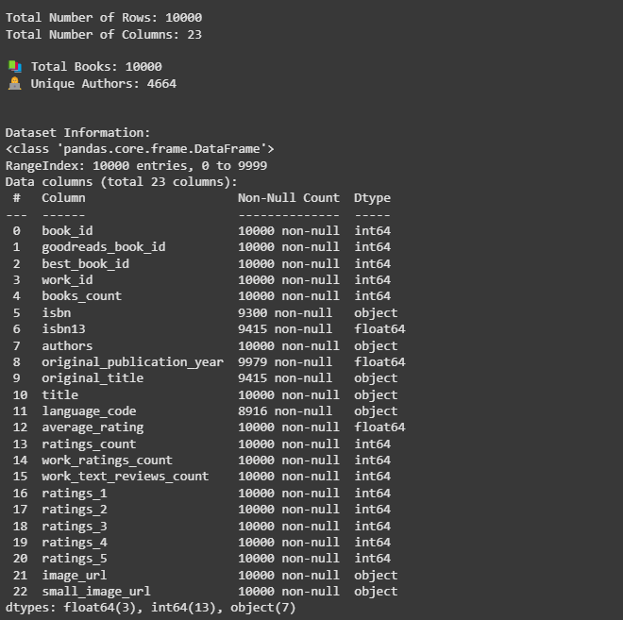
The dataset provides valuable insights into which books and authors attract the most engagement, helping publishers and libraries optimize book selections.
The analysis of 10,000 books provides insights into reader preferences, author popularity, and rating trends over time.
After careful analysis of the data,
Total Number of Rows = 10000
Total Number of Columns = 23
DATASET PROFILE:
UNDERSTANDING THE STRUCTURE OF THE DATASET
Dataset: https://github.com/zygmuntz/goodbooks-10k/blob/master/books.csv

Slide 3
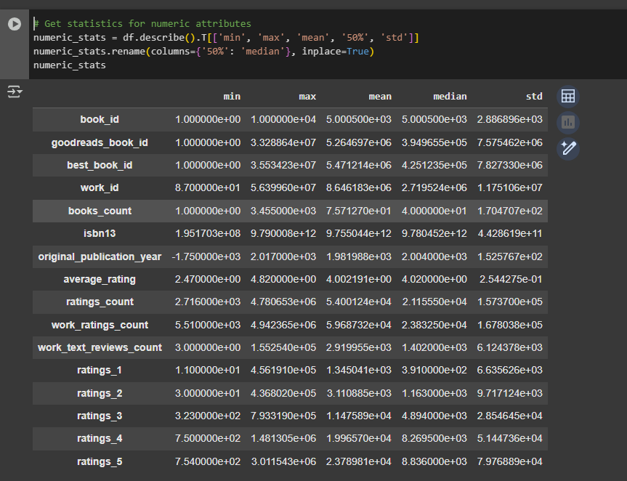
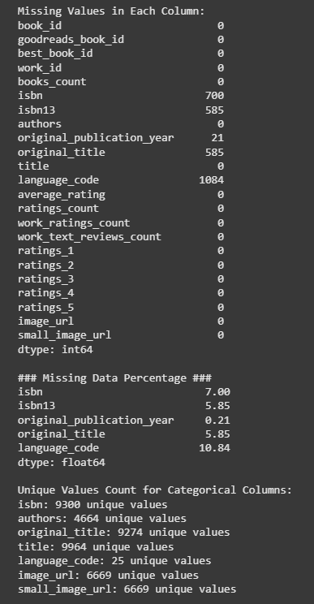
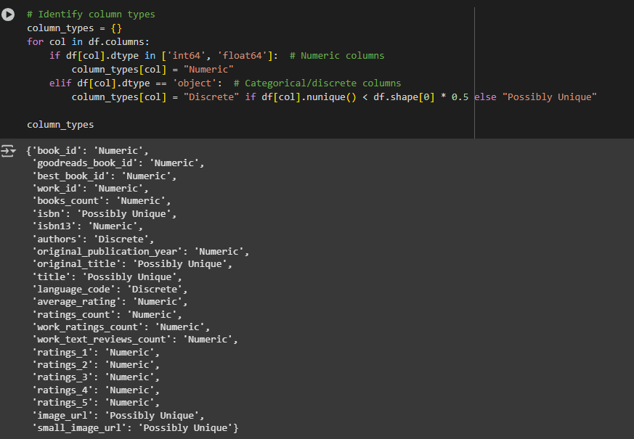
NUMERIC ATTRIBUTES STATISTICS
For key numeric attributes:
average_rating: Min 2.47, Max 4.82, Mean 4.00, Median 4.02, Std Dev 0.25
ratings_count: Min 2.716, Max 4.780653, Mean 5.4001, Median 2.1156, Std Dev 1.57369
original_publication_year: Min -1.750, Max 2.017, Mean 1.982, Median 2.004, Std Dev 1.52
MISSING DATA
isbn: 7.00% missing
isbn13: 5.85% missing
original_title: 5.85% missing
language_code: 10.84% missing
ATTRIBUTE TYPES
Numeric attributes: 14 (e.g., average_rating, ratings_count, original_publication_year)
Discrete attributes: 6 (e.g., authors, language_code)
Possibly unique attributes: 3 (e.g., isbn, title, image_url)

Slide 4
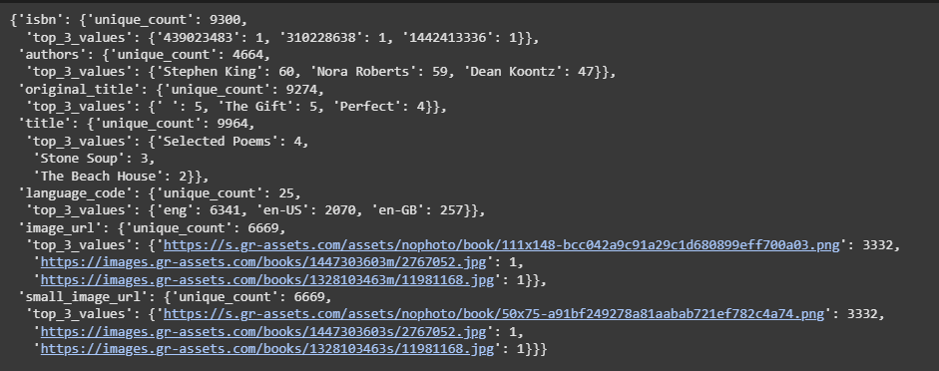
KEY TAKEAWAYS AFTER ANALYSIS:
DISCRETE ATTRIBUTES STATISTICS
Authors: 4664 unique values
Top 3 authors:
Stephen King (60 books)
Nora Roberts (59 books)
Dean Koontz (47 books)
Language_code: 25 unique values
Most common:
eng (6341 times)
en-US (2070 times)
Negative values for the year - Notable minimum value for original_publication_year is (-1750) –
There are multiple instances of the same book titles - The Gift occurs 5 times under original_title.
- Selected Poems is listed 4 times.
A significant proportion of missing data exists for isbn (7%) and language_code (10.84%).
- The absence of isbn could impact book identification.
- Missing language_code may result in inaccurate book categorization.
By understanding these trends, we can anticipate future reading preferences and make informed decisions in publishing books in the near future.

Slide 5
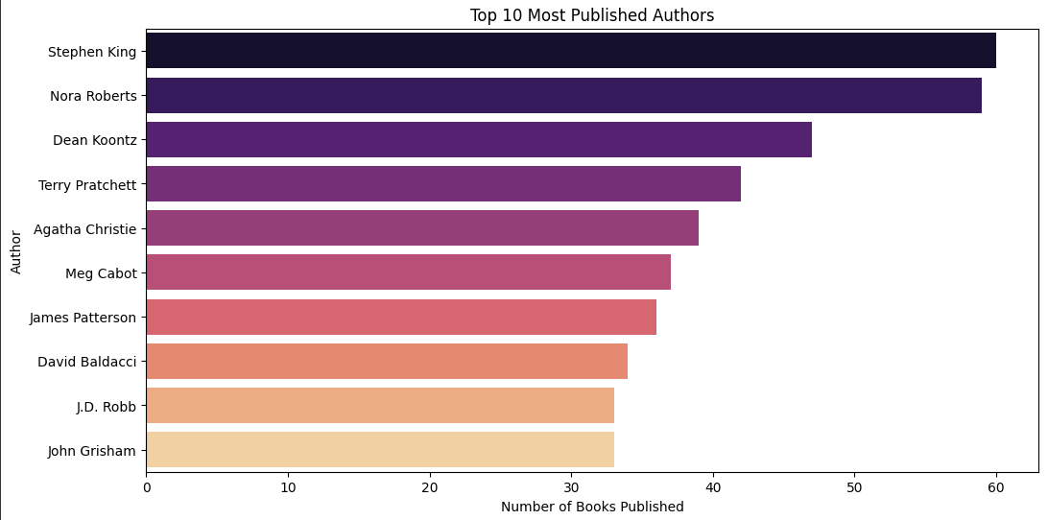
TOP 10 MOST PUBLISHED AUTHORS
Stephen King - 60
Nora Roberts - 59
Dean Koontz - 47
Terry Pratchett - 42
Agatha Christie - 39
Meg Cabot - 37
James Patterson - 36
David Baldacci - 34
J.D. Robb - 33
John Grisham - 33
Looking at the data, we can see that some authors stand out with significantly more published books than others. For example, the first few authors may have a significantly higher count, suggesting that these authors are either prolific writers or have many works attributed to them across various genres.
It’s important to note whether these top authors are concentrated in particular genres. Are they known for a specific style of writing, or are they publishing across diverse genres? Identifying this can help us understand if there are patterns or shifts in literary trends within the dataset.

Slide 6
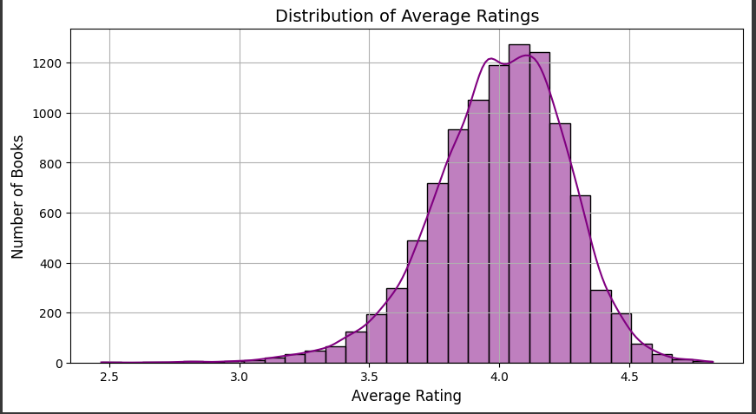
DISTRIBUTION OF AVERAGE RATINGS
The histogram of average ratings provides a clear understanding of how book ratings are distributed across the dataset.
1. Most Books Have High Ratings (Skewed Right)
The majority of books have ratings between 3.5 and 4.5, meaning readers generally give positive feedback.
Very few books have ratings below 3.0, indicating that most books in the dataset are well-received.
2. Peak Near 4.0–4.5
There is a clear peak around 4.0–4.5, suggesting that many books are rated highly.
This could indicate that readers tend to give favorable ratings rather than low ones.
3. Few Extremely High or Low Ratings
There are fewer books rated below 3.0, which means very few books in the dataset received poor reviews.
Similarly, while some books have ratings close to 5.0, they are not as common.
HOW THIS HELPS?
Recommendation Systems Need to Evolve: Since many books share similar ratings, book platforms should incorporate advanced recommendation models based on user preferences, reviews, and reading history.
Book Marketing: New authors must work harder to get positive reviews and stand out among similarly rated books. Authors and publishers need additional strategies (reviews, marketing, SEO, social media) to differentiate their books.

Slide 7
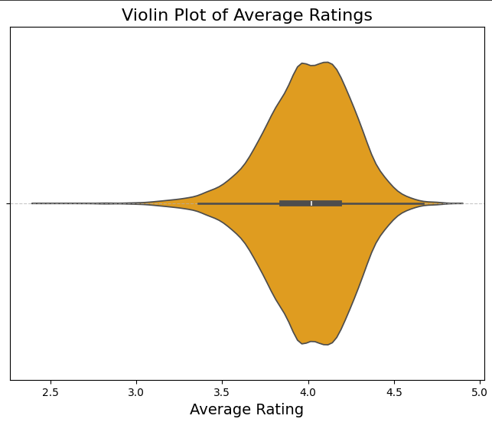
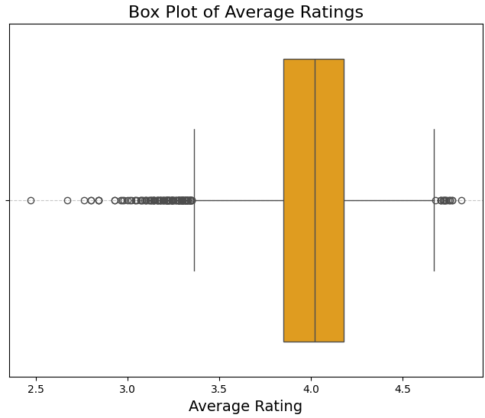
VIOLIN PLOT AND BOX PLOT OF DISTRIBUTION OF AVERAGE RATINGS
There is a clear peak around 4.0, suggesting that many books are rated highly.

Slide 8
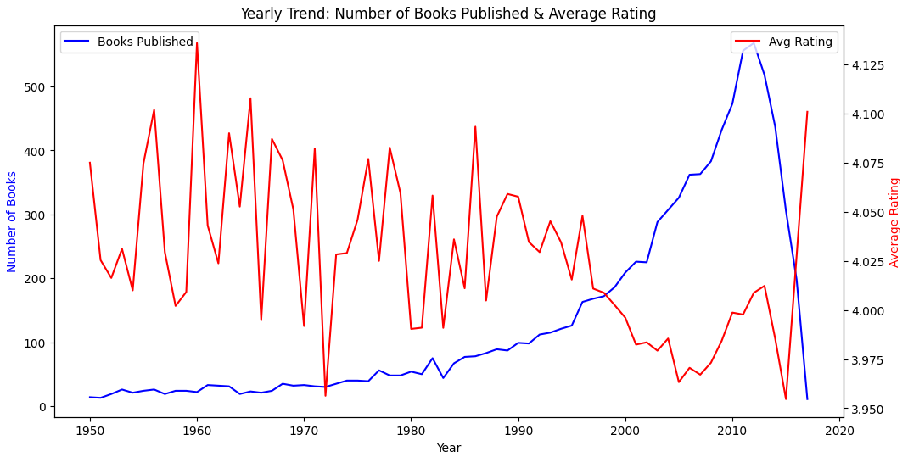
ANALYSIS OF TEMPORAL PATTERN OF BOOK RATINGS AND PUBLICATIONS
Data-Driven Marketing:
Use trends to target specific reader demographics or genres that align with historical success.
Leverage analytics to predict future trends and stay ahead of the competition.
Author Development:
Invest in emerging authors that show potential for high ratings.
Provide resources for authors to improve writing quality, ensuring consistent reader satisfaction.
Marketing:
Experiment with new formats (e.g., audiobooks, e-books) for current changing reader preferences.
Explore partnerships with social-media influencers or book clubs to boost visibility and engagement.
The above visualization explains the Year-to-Year Trend → Average book ratings and number of books published per year.
The data shows fluctuations in the number of books published yearly, with certain years (e.g., 2000s) experiencing higher publication rates.
The average ratings of books have remained relatively stable over the years, with minor fluctuations.

Slide 9
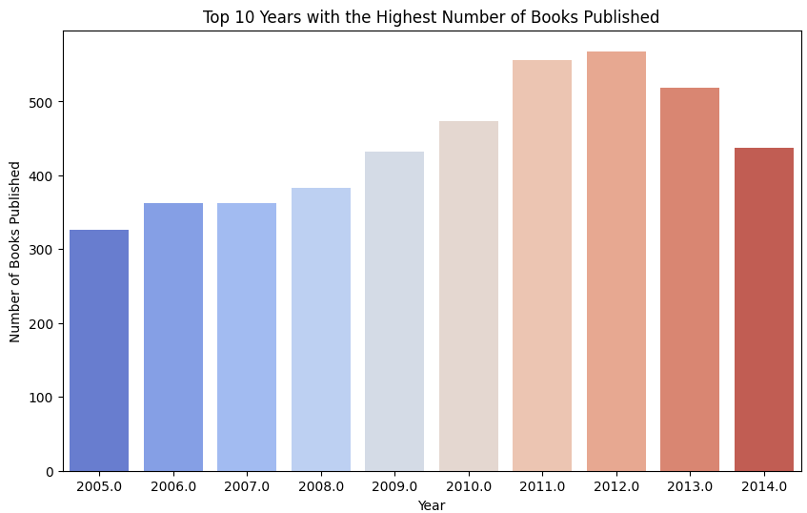
TOP 10 YEARS WITH HIGHEST NUMBER OF BOOKS
The Growth in these years helps us to understand the self-publishing platforms (e.g., Amazon Kindle [Launched in 2007], Wattpad).
There was increased accessibility to publishing technology (e-books, audiobooks).
RECOMMENDATIONS
Publishers and authors should study these years to understand trends and replicate successful patterns.
Use past data to forecast high-engagement years and time releases accordingly.
Authors should invest in strong marketing & visibility strategies rather than just focusing on publishing volume.
Align publishing schedules with key global and industry trends to maximize reach

Slide 10
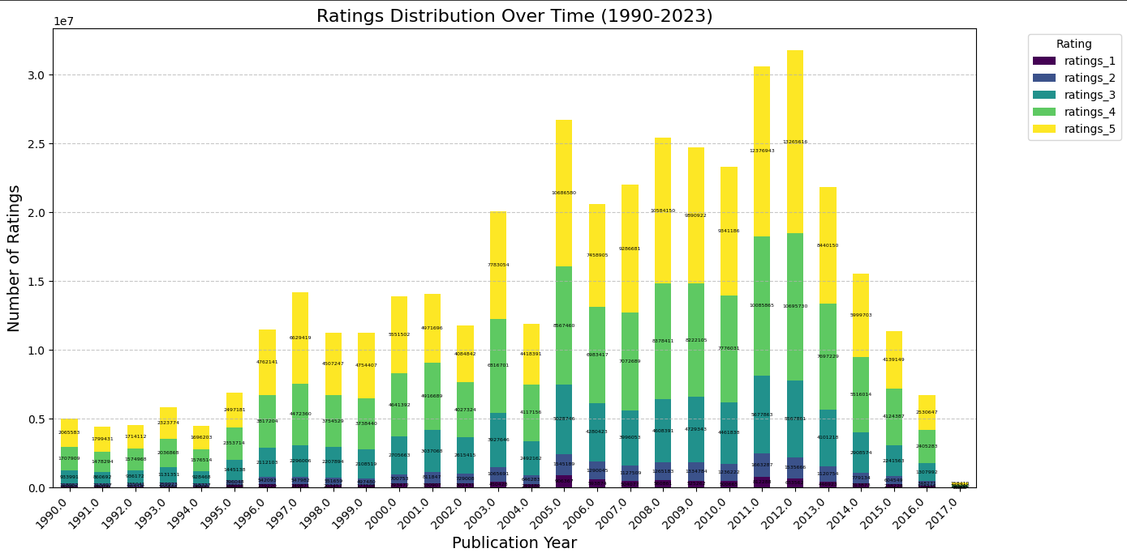
RATINGS DISTRIBUTION FROM 1990 - 2023
SUGGESTIONS:
Promote underrated books from years with lower ratings by highlighting their strengths or repositioning them in the market.
Identify potential gaps or weaknesses in the publishing process (e.g., editing, cover design, or content quality).
Engage with readers by promoting highly rated books or creating content around them (e.g., author interviews, book clubs, or social media campaigns).
Build a loyal reader base by focusing on books that consistently receive high ratings.
Collaborate with authors whose books consistently receive high ratings. Use feedback from low-rated books to improve future publications. Provide feedback to authors whose books receive lower ratings to improve future works.
Stock more copies of books from years with high ratings and demand.
Clear inventory of books from years with low ratings by offering discounts or promotions.

Slide 11
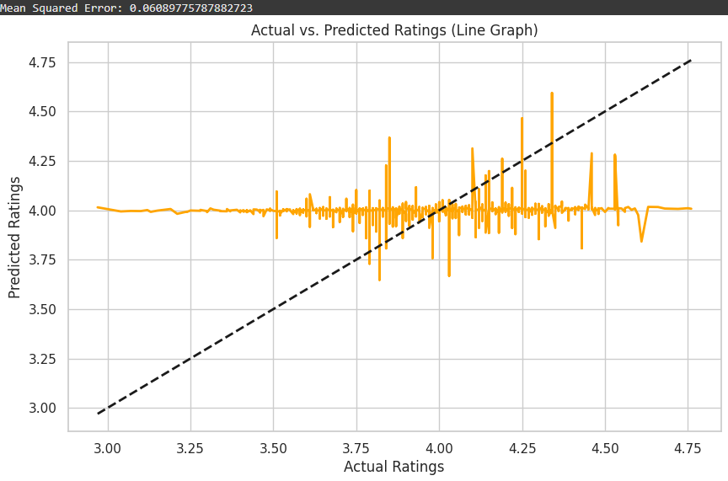
EXAMPLE ML PROBLEM - PREDICTING BOOK RATINGS
Predicting Book Ratings:
The linear regression model predicts book ratings using features like books_count, ratings_count, and work_text_reviews_count to predict the average_rating.
This analysis provides valuable insights into customer preferences and allows for better-targeted marketing efforts, content strategies, and inventory management decisions, which helps to optimize the approach based on data-driven predictions.
By comparing actual vs. predicted ratings, stakeholders can assess model accuracy and identify patterns or discrepancies, leading to informed decisions on marketing strategies and content development.

Slide 12
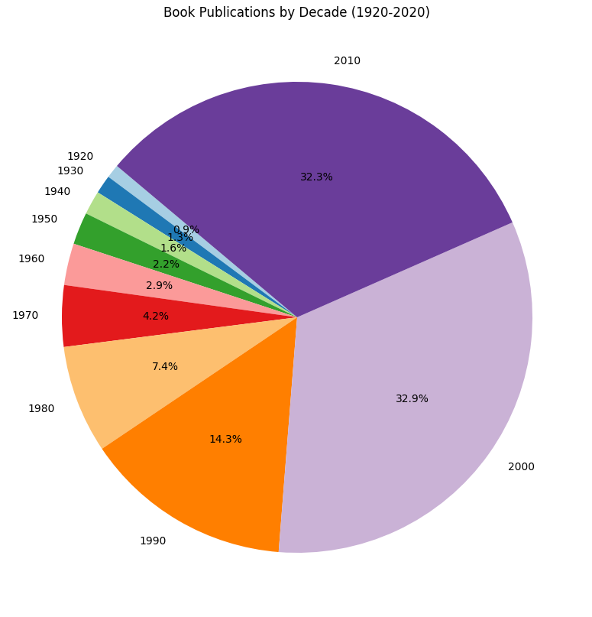
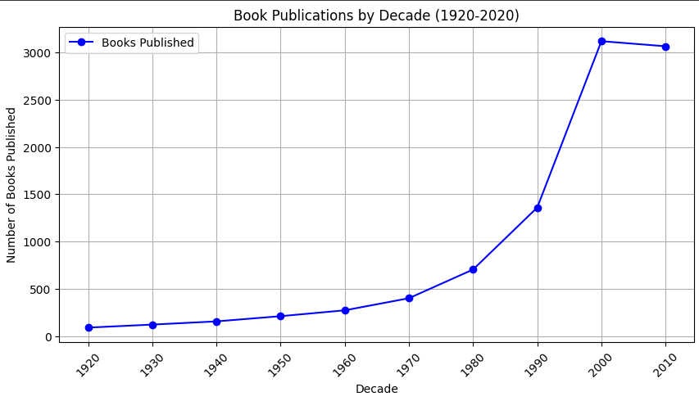
BOOK PUBLICATION BY DECADE 1920 - 2020
SUGGESTIONS
Market Insights: Helps publishers track trends, predict demand, and identify popular book genres over time.
Business Strategy: Guides investment in reprints, digital formats, or niche markets based on publication trends.
Marketing & Sales: Supports targeted promotions, content strategies, and audience engagement based on decade-wise interests.

Slide 13
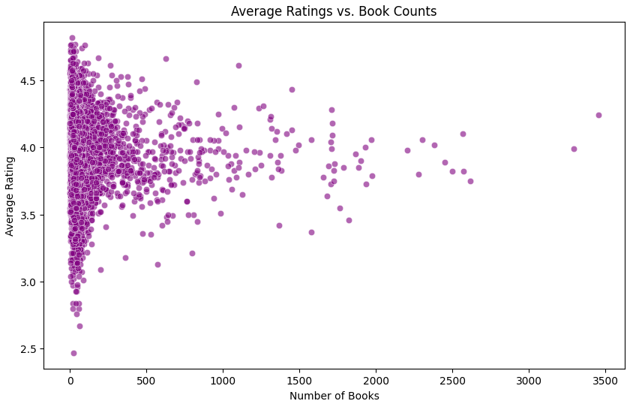
SERIES OF PLOTS FOR DEVELOPING AN ML MODEL:
Average Ratings vs Book Counts

Slide 14
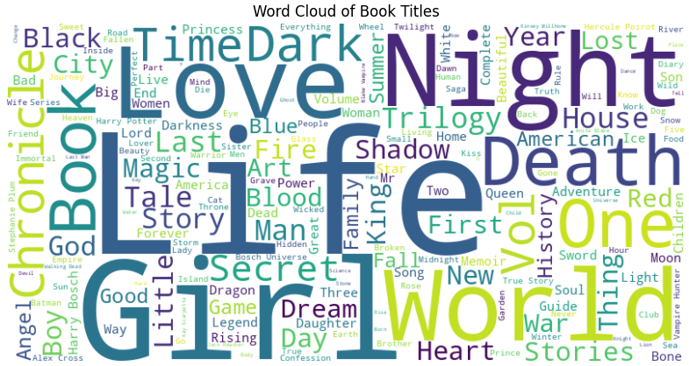
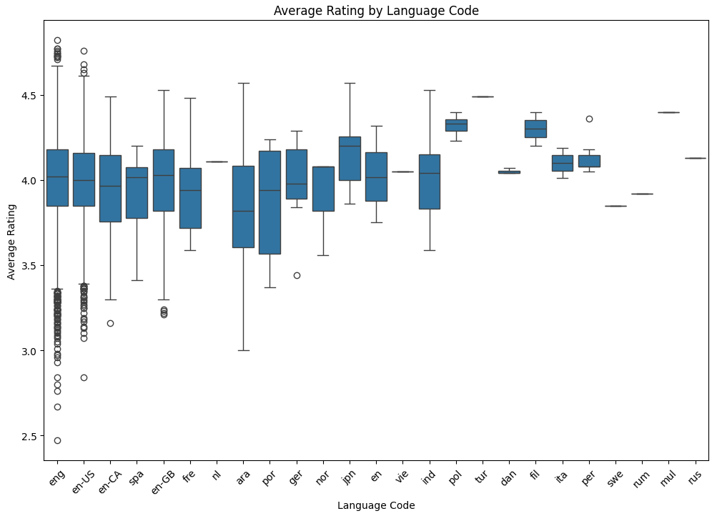
Word Cloud of Book Titles
[For Marketing]
Average Ratings by Language Code

Slide 15
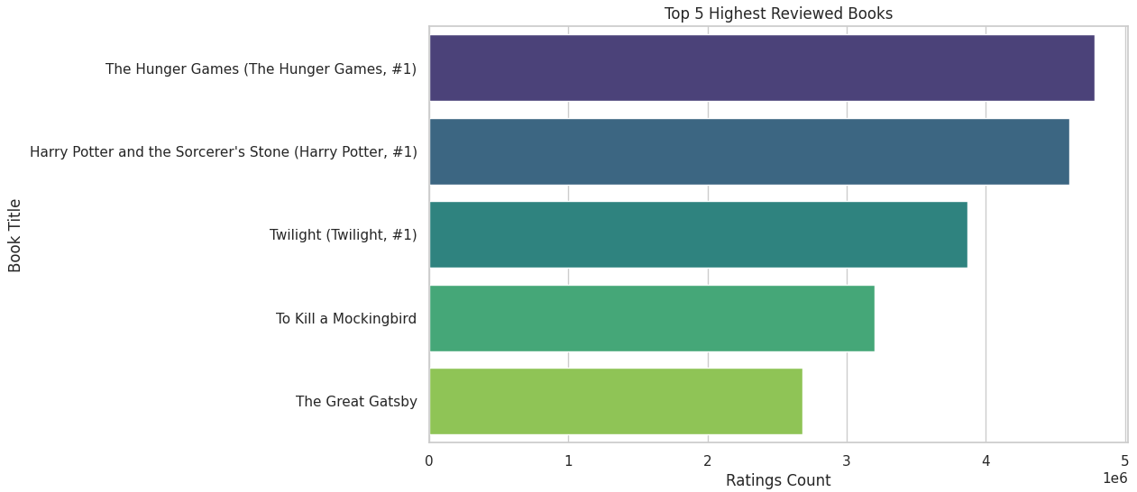
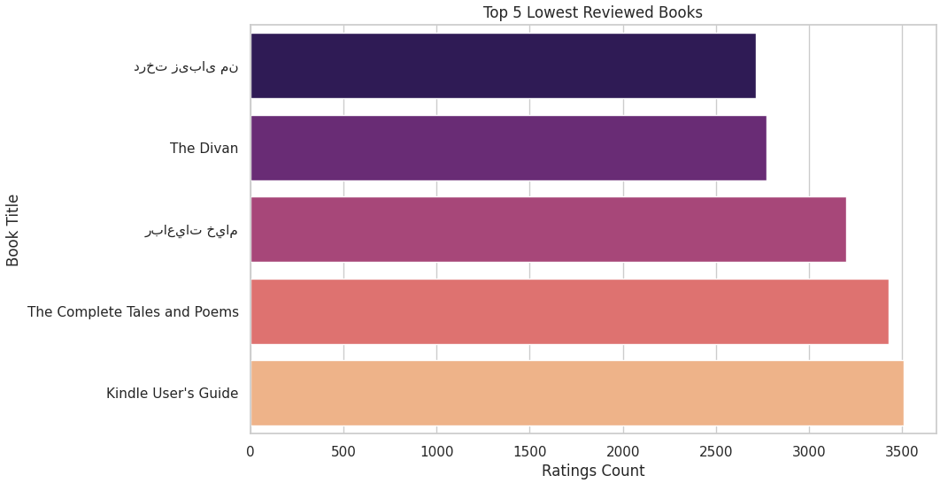
Top 5 Highest Reviewed Books
Top 5 Lowest Reviewed Books

Slide 16
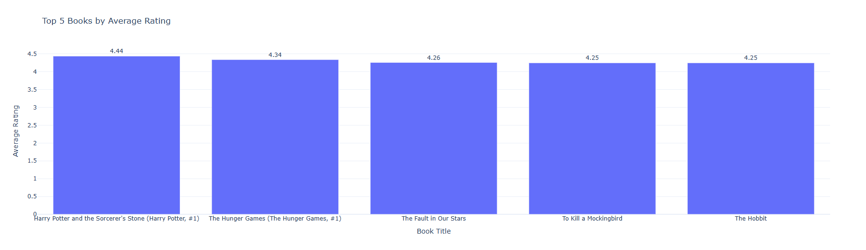
INTERACTIVE DISTRIBUTION OF THE TOP 5 BOOKS WITH RATINGS USING PLOTLY EXPRESS

Slide 17
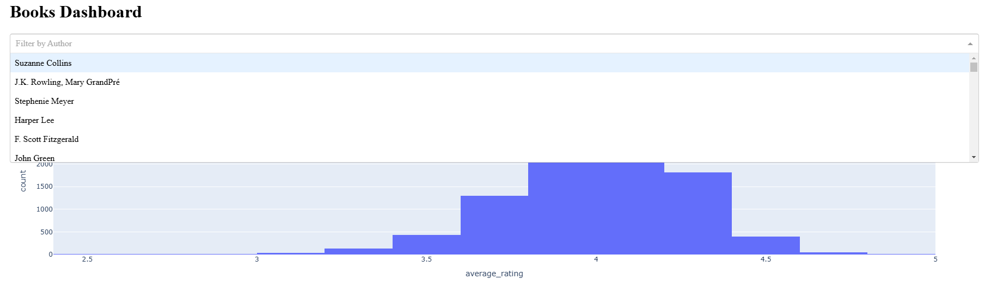
INTERACTIVE DASHBOARD USING AUTHORS FOR FILTERING

Slide 18
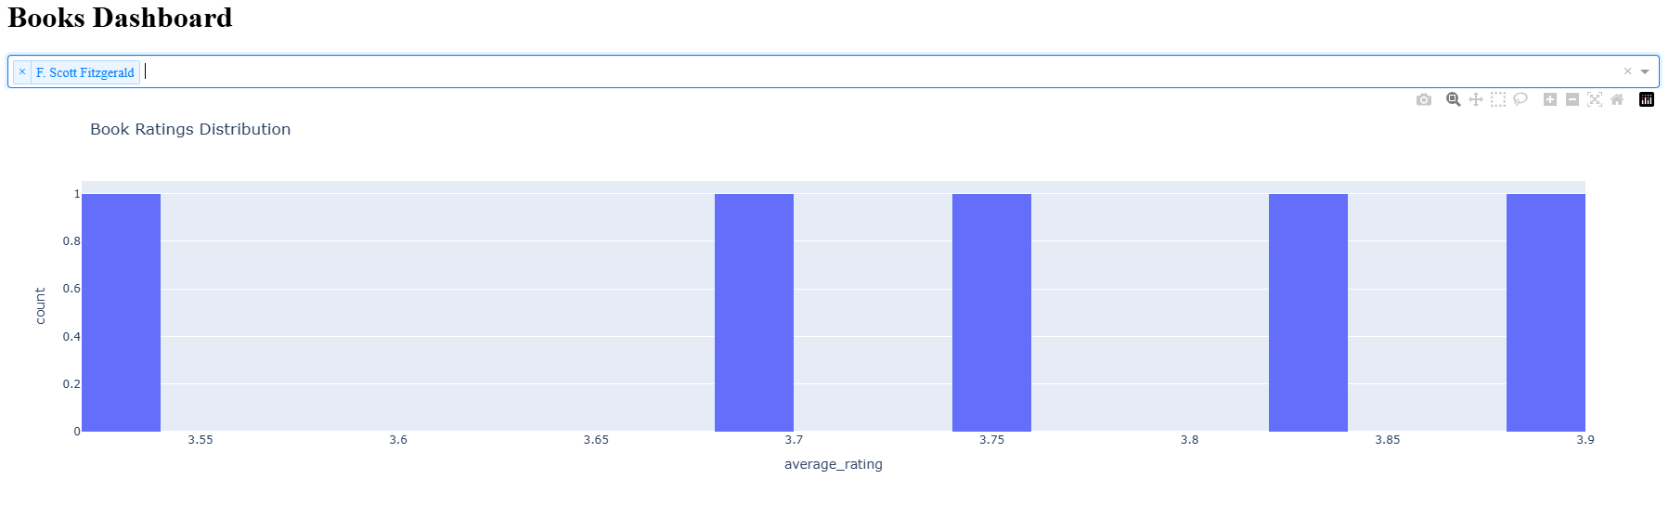
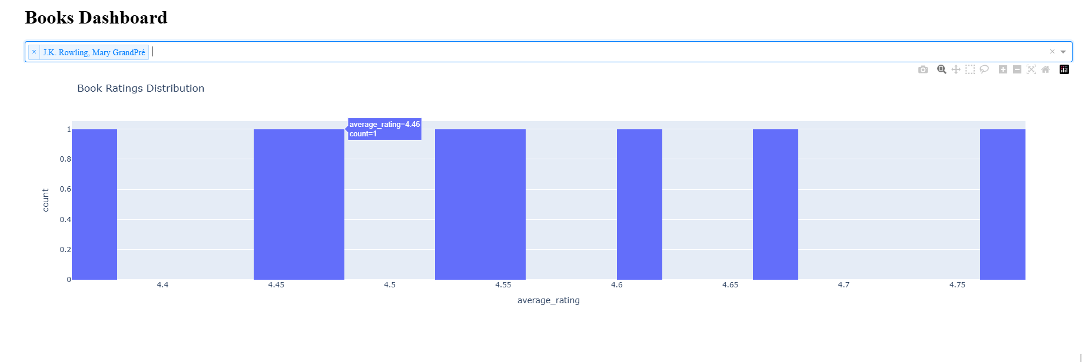

Slide 19
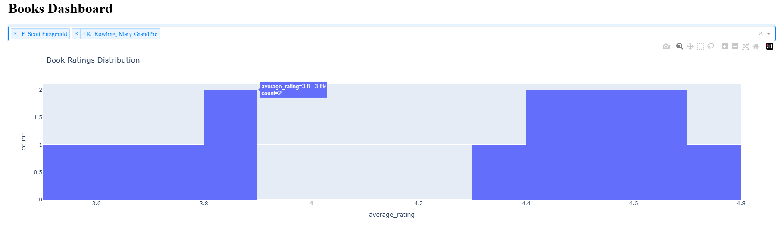

Slide 20

CONCLUSION
This analysis provides valuable insights into book popularity and rating prediction.
This includes the distribution of book ratings and counts, identifying relationships between features like books_count, ratings_count, and average_rating.
Through a linear regression model, prediction of book ratings and evaluation of its performance can be performed. Visualizations such as scatter plots, residual plots, and heatmaps helped assess feature relationships and model performance.
Key findings show that popular books like,The Hunger Games and Harry Potter dominate ratings, and features like ratings_count and work_text_reviews_count significantly influence predictions.

